Slide 1
Mero TV Deployment Plan
Version<1.0>
Prepared by:
Rijan Prajapati Rasik Shrestha Dipesh Khadgi Dipesh tha Shrestha

Slide 2
Contents
1. Introduction
Purpose
Scope
Overview
Definitions
General Description
  Product Perspective
  Product Functions
  User Characteristics
Specific Requirements
  Functional Requirement
  Technical Issues
  User Interface Description
Attributes
  Reliability
  Availability
  Security
  Maintainability
  Portability
Deployment
  Purpose
  Scope
References
AMC
Support

Slide 3
1. Introduction
Mero Sky Cable, the one stop solution for TV and Broadband solution. Our root started from early 1995 and has become Nepal’s leading entertainment company, serving local communities. Our core service started from providing cable TV, since then we have widened and transformed our network to Digital TV and high speed Internet solution. We offer cutting edge solution for delivering your favorite HD and SD TV channels from all over the world. Bringing happiness to peoples life by delivering their favorite TV channels, entertaining and creating joyful environment to all the friends and family members. We are part of the community and remain the everyday life of communities. Providing a best solution to our customers in their everyday life is our success. Mero tv services are affordable to everybody and aim to provide millions of household affordable services. We are very committed to provide better technology and improve our service and technology as time comes in.
Purpose
This document is meant to delineate the features of OSM & VOD, so as to serve as a
guide to the developers on one hand and a software validation document for the prospective client on the other. It specializes in and provides streaming media and video-on-demand online and DVD by mail. The purpose of the document is to collect and analyze all assorted ideas that have come up to define the system, its requirements with respect to consumers. Also, we shall predict and sort out how we hope this product will be used in order to gain a better understanding of the project, outline concepts that may be developed later, and document ideas that are being considered, but may be discarded as the product develops.In short, the purpose of this SRS document is to provide a detailed overview of our software product, its parameters and goals. This document describes the project's target audience and its user interface, hardware and software requirements. It defines how our client, team and audience see the product and its functionality. Nonetheless, it helps any designer and developer to assist in software delivery lifecycle (SDLC) processes.Members can watch as much as they want, anytime, anywhere, on nearly any internet-connected screen. Member can play, pause and resume watching, all without commercials or commitments.
Scope

Slide 4
People love TV content, but they don't love the linear TV experience, where channels present programs only at particular times on non-portable screens with complicated remote controls. Now internet TV - which is on-demand, personalized, and available on any screen - is replacing linear TV. Changes of this magnitude are rare. Radio was the dominant home entertainment media for nearly 50 years until linear TV took
over in the 1950’s and 1960’s Linear video in the home was a huge advance over radio, and very large firms emerged to meet consumer desires over the last 60 years. The new era of internet TV, which began a decade ago, is likely to be very big and
enduring also, given the flexibility and ubiquity of the internet around the world.
Overview
TV Broadcast applications need a mechanism to identify and locate the components building the application. The URI scheme is a useful tool for that as it opens possibilities for seamless transition in referencing resources at TV Broadcast transport and Internet sites. URI schemes to locate resources at the Internet are well-known, and are not further observed in this document. URI schemes to locate resources in a TV Broadcast transport channel have been proposed, but most are designed with a particular TV Broadcast transport environment in mind. Next to locating components at TV Broadcast transport channels, another aspect of TV Broadcast URIs concerns referencing the events. In the first place, events are accessible at the TV Broadcast transport channel, possibly at several channels and at multiple periods of time. The above mentioned URI schemes also address this aspect, but all in their own way. In the second place, the content may be stored and made available through another path than the TV Broadcast transport channel. Most evident are local storage, like VCR-type of devices, and the Internet itself. Local storage devices can be connected through an in-home network to the user agent presenting the application. Local storage in the sense of the client's local file system or in the sense of cache buffering are not observed in this document.TV Broadcast content delivered through a so-called IP-tunnel is considered as content made available through the Internet. An IP-tunnel refers to a forwarding path which is logically separated from the conventional TV Broadcast transport protocol but uses the same physical transmission link.
2. General Description
Product Perspective

Slide 5
The product is new for this business and is not replaced by any existing product. The description for this product is given below.
System Interfaces: The application enables users to login directly to application from their desktop .
User 1
Database
server
User2
User
n
Database Server: The information of the COMS will be stored in the Database Server. It can also be called as Data Services (MS Access).
User interfaces: This section describes the application with the help of word document proto type screen flow design. The next few screens explain the navigation of each and every page of user interface system.

Slide 6
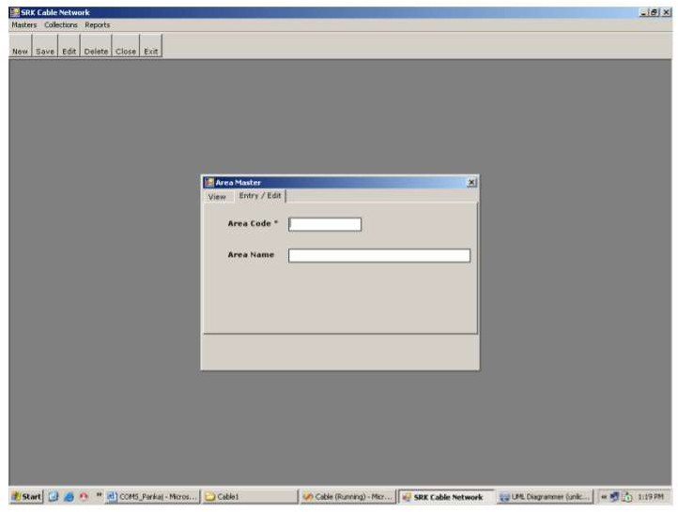
Product Functions
TBS is an product which is used by cable operators. It helps the cable management team to manage their customers and provides the information about various channels.
Customers: customers are given the front end access of this program This is how the customers will be allowed to access the program and what they are able to do.

Slide 7
(v1)Check the Program Schedule: Customers are able to check the schedule
for the program or channel they want to see.
(v2)Able to Register: Customers are able to register themselves with their
information to the certain plan which suits best for them.
(v3)Subscribe to Selected Program/Channel: They are able to select and subscribe for the plan they have chosen. They will be able to unsubscribe the plan whenever they want.
Accounting Officer : Accounting officer is to handle all the payment within the company and the customer.
  (A1)Record subscription payments: This officer would be able to record all the subscription done by a customer and manage the payments.
  (A2)Send out payment reminders automatically: He/she will be able to command the system to send the payment reminders.
Channel operating officer: This officer will control all the main function of the system.
(C1) Add/Remove/Update Programs (Audio, Video, Text): Will be able to control overall multimedia with the help of system.
C2 Provide Test Frequency to Cable/Individual: Check the frequency and provide information to the cable and individual of the organization.
C3 Approve or Reject Viewing requests: Will be able to approve or rejects the viewing requests from the customers.
C4 Allow members to make Payment over the internet: All the paid members have to pay in monthly basis this officer will allow the member to make payment over the internet.
C5 Must be able to Share to Social Media: This officer will be responsible for handling the social media where he can share the information to social media like Facebook , Instagram e.t.c with the help of system.
Manager: Manager will be the one who manage overall system. He/she will be able to
M1 Total subscriber: Can see the total number of subscriber.
M2 Monthly Collection (Payment Reports): Manager will be able to get the monthly payments reports from the system.
M3 Frequency Load Report/Area Wise: Manager will be able to see or collect information about the frequency load report by area wise.

Slide 8
Head: This is the part of the system. The people who are working on the this part of the system can view or change the page. The Head page is access to administrator only. There is also sub part for Head like type of head they are.
<Summarize the major functions the product must perform or must let the user perform. Details will be provided in Section 3, so only a high level summary (such as a bullet list) is needed here. Organize the functions to make them understandable to any reader of the SRS. A picture of the major groups of related requirements and how they relate, such as a top level data flow diagram or object class diagram, is often effective.>
User Classes and Characteristics
<Identify the various user classes that you anticipate will use this product. User classes may be differentiated based on frequency of use, subset of product functions used, technical expertise, security or privilege levels, educational level, or experience. Describe the pertinent characteristics of each user class. Certain requirements may pertain only to certain user classes. Distinguish the most important user classes for this product from those who are less important to satisfy.>
Operating Environment
<Describe the environment in which the software will operate, including the hardware platform, operating system and versions, and any other software components or applications with which it must peacefully coexist.>
Design and Implementation Constraints
<Describe any items or issues that will limit the options available to the developers. These might include: corporate or regulatory policies; hardware limitations (timing requirements, memory requirements); interfaces to other applications; specific technologies, tools, and databases to be used; parallel operations; language requirements; communications protocols; security considerations; design conventions or programming standards (for example, if the customer’s organization will be responsible for maintaining the delivered software).>
User Documentation
<List the user documentation components (such as user manuals, on-line help, and tutorials) that will be delivered along with the software. Identify any known user documentation delivery formats or standards.>
Assumptions and Dependencies
<List any assumed factors (as opposed to known facts) that could affect the requirements stated in the SRS. These could include third-party or commercial components that you plan to use, issues around the development or operating

Slide 9
environment, or constraints. The project could be affected if these assumptions are incorrect, are not shared, or change. Also identify any dependencies the project has on external factors, such as software components that you intend to reuse from another project, unless they are already documented elsewhere (for example, in the vision and scope document or the project plan).>
3. Specific Requirement
User Interfaces
<Describe the logical characteristics of each interface between the software product and the users. This may include sample screen images, any GUI standards or product family style guides that are to be followed, screen layout constraints, standard buttons and functions (e.g., help) that will appear on every screen, keyboard shortcuts, error message display standards, and so on. Define the software components for which a user interface is needed. Details of the user interface design should be documented in a separate user interface specification.>
Hardware Interfaces
<Describe the logical and physical characteristics of each interface between the software product and the hardware components of the system. This may include the supported device types, the nature of the data and control interactions between the software and the hardware, and communication protocols to be used.>
Software Interfaces
<Describe the connections between this product and other specific software components (name and version), including databases, operating systems, tools, libraries, and integrated commercial components. Identify the data items or messages coming into the system and going out and describe the purpose of each. Describe the services needed and the nature of communications. Refer to documents that describe detailed application programming interface protocols. Identify data that will be shared across software components. If the data sharing mechanism must be implemented in a specific way (for example, use of a global data area in a multitasking operating system), specify this as an implementation constraint.>
Communications Interfaces
<Describe the requirements associated with any communications functions required by this product, including e-mail, web browser, network server communications protocols, electronic forms, and so on. Define any pertinent message formatting. Identify any communication standards that will be used, such as FTP or HTTP. Specify any communication security or encryption issues, data transfer rates, and synchronization mechanisms.>
Performance Requirements
<If there are performance requirements for the product under various circumstances, state them here and explain their rationale, to help the developers understand the intent and make suitable design choices. Specify the timing relationships for real time systems. Make such requirements as

Slide 10
specific as possible. You may need to state performance requirements for individual functional requirements or features.>
Safety Requirements
<Specify those requirements that are concerned with possible loss, damage, or harm that could result from the use of the product. Define any safeguards or actions that must be taken, as well as actions that must be prevented. Refer to any external policies or regulations that state safety issues that affect the product’s design or use. Define any safety certifications that must be satisfied.>
Security Requirements
<Specify any requirements regarding security or privacy issues surrounding use of the product or protection of the data used or created by the product. Define any user identity authentication requirements. Refer to any external policies or regulations containing security issues that affect the product. Define any security or privacy certifications that must be satisfied.>
Software Quality Attributes
<Specify any additional quality characteristics for the product that will be important to either the customers or the developers. Some to consider are: adaptability, availability, correctness, flexibility, interoperability, maintainability, portability, reliability, reusability, robustness, testability, and usability. Write these to be specific, quantitative, and verifiable when possible. At the least, clarify the relative preferences for various attributes, such as ease of use over ease of learning.>
Business Rules
<List any operating principles about the product, such as which individuals or roles can perform which functions under specific circumstances. These are not functional requirements in themselves, but they may imply certain functional requirements to enforce the rules.>
1. Other Requirements
<Define any other requirements not covered elsewhere in the SRS. This might include database requirements, internationalization requirements, legal requirements, reuse objectives for the project, and so on. Add any new sections that are pertinent to the project.>
Appendix A: Glossary
<Define all the terms necessary to properly interpret the SRS, including acronyms and abbreviations. You may wish to build a separate glossary that spans multiple projects or the entire organization, and just include terms specific to a single project in each SRS.>
Appendix B: Analysis Models
<Optionally, include any pertinent analysis models, such as data flow diagrams, class diagrams, state-transition diagrams, or entity-relationship diagrams.>

Slide 11
Appendix C: To Be Determined List
<Collect a numbered list of the TBD (to be determined) references that remain in the SRS so they can be tracked to closure.>
Attributes
  Reliability
Mero Tv has has servers all over the world so you are likely not receiving your content from far away. But I believe one of the biggest things is the bandwidth you have, Mero Tv is very good at streaming across low bandwidth
connections due to excellent data compression algorithms that make the stream more stable.
But in saying that i have seen many many websites that transmit steams that are jut as good as mero Tv if not better in some cases. So mero tv is reliable.
  Availability
As for now, Mero TV is available on over 200 countries. As it is free on play store and app store, everyone can download and enjoy mero tv. Anyone can enjoy mero tv if they are connected to internet with www.merotv.com as well as in mobile
application.
  Security
Mero tv uses contractual and technical measures designed to prevent advertising partners from accessing information regarding specific title
selections you make, URLs you land on, or shows you have watched on our service. We do not share information about title selections or your shows you have watched on our service. So no one will know what you are watching expect you.
  Maintainability
As there may be some problem form the user. So there is a team that control and maintain the problem of the user. The team solves the problems of the user. Mero Tv provide monthly update on the application for the better
experience for the user.
  Portability
User can stream, watch movies ,tv shows, cartoon, anime anywhere they are if they have internet.

Slide 12
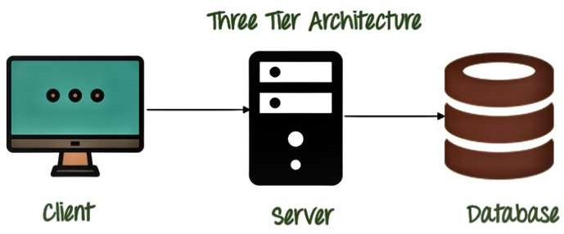
Three-tier Architecture Diagram Three-tier Architecture include:
The Presentation Layer (Client): This layer occupies the top level and displays information related to services available on a website in the form of a graphical user interface (GUI). It constitutes the front-end layer of the application and the interface with which end-users will interact through a web-based application. This layer is what user sees and receives input and displays output.
The Application Tier (Server): This layer controls the application’s core functionality by performing detailed processing and is usually coded in programming languages, such as Python, Java, C++, .NET, etc.
The Database Tier: Data in this tier is kept independent of application servers or business logic, and is managed and accessed with programs, such as MongoDB, Oracle, MySQL, and Microsoft SQL Server.

Slide 13
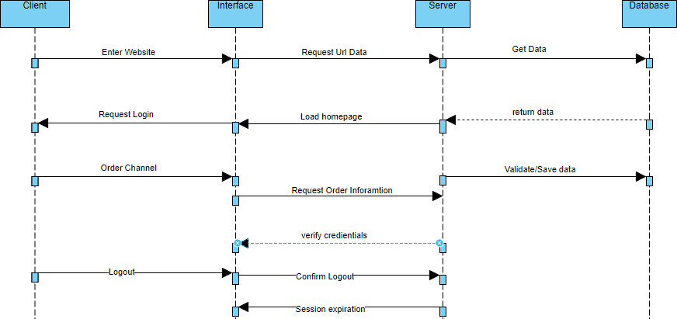
Fig: Sequence Diagram

Slide 14
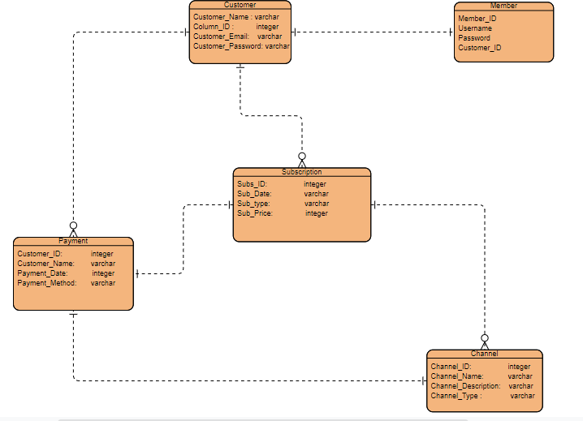
Fig: ER-Diagram
UX Design: https://rasikshrestha75.wixsite.com/mysite

Slide 15
Deployment
The deployment plan outlines the scope, approach and execution planned for the deployment of the project deliverables. The plan includes, where relevant, information about system support, issue tracking, escalation processes, roles and responsibilities before, during, and after deployment. The deployment plan is intended to provide clients, stakeholders and support personnel with a smooth transition to the new product or software being deployed. The deployment plan describes each step of the deployment process at each deployment location, whether there is one site or multiple sites, or one deployment or a phased deployment planned. The Deployment Plan defines all of the work steps for complete deployment, and who does them.
  Purpose
The proposed system will incorporate robust features such payment option, in which customer can choose the number of channels, they want and make the payment. They can also register to the system and can also view the program schedule that will be broadcasted. In other hands, file hosting and file management, user data, better group collaboration tools, and online testing capabilities. The purpose of Deployment plan is to layout the tasks and activities that need to take place to efficiently deliver the system from the development environment to the production, operations and maintenance environment.
  Scope
The Television Broadcasting System is a web-based system which enables the television channels to broadcast its programs in a platform which is accessible worldwide and it helps the user to subscribe and check on the programs of the channels. The Channel operators can maintain their channels and its programs. The system needs Internet to fetch and display results. All channel information and user information is maintained in a database, which is located on a web server. Above all, we hope to provide a comfortable user experience along with the best pricing available. The scope of work will include functioning of all the installed hard software and other accessories installed during the operation of the contract.
6. References
https://www.washington.edu/asa/project-management-draft/project-management- resources/templates/execution-deployment-plan https://www.plutora.com/blog/deployment-planning-success

Slide 16
7.AMC
This agreement is made between Mero TV, a company registered under the Companies Act, 2006 and having its registered office at Kathmandu, Nepal and a company registered under the Companies Act, 2006.
SCOPE OF AGREEMENT:
The contract shall be in force for the period ranging from 1st September, 2020 to 30th September, 2021 and shall cover all those items as specified in this agreement.
SCOPE OF WORK:
The vendor shall provide the following services to keep the equipment in good working condition.
The scope of work will include functioning of all the installed hard software and other accessories installed during the operation of the contract.
The vendor shall maintain adequate spare machine and other spares at the site to facilitate any temporary replacement.
Engineers can be replaced either on the request of this office or due to unavoidable reasons like resignation, long leave, etc. in the middle of the contract period and in that case suitable replacement acceptable to this office must be provided as approved immediately.
The scope of work also includes repairmen of software issue like Network failure immediately / Real-time basis including the track and location of Network down/ Fiber cut/ installation, inspect, maintain, and repair antennas, cables, and
amplifying equipment used in cable television transmission.
No person below the age of 18 years shall be deputed to this office.
Complaint can be registered either telephonically or by e-mail by respective branch/Office and proper record of the complaints to be maintained by the AMC Vendor. Escalation matrix and name of persons coordinating AMC jobs should be

Slide 17
submitted to IT Department, Regional Office Kathmandu, Nepal immediately
after AMC is awarded.
In case any engineer or the attendant wants to avail leave of short duration, he must inform in advance to this office and the Contractor. Engineer or attendant can only be relieved for that period after getting suitable replacement from the Contractor.
A logbook shall be maintained in which the vendor shall record all the complaints made and parts taken out of branches/office for repair.
3. Includes:
The AMC Includes:
Checking of power supply source for proper grounding and safety of equipment.
Updating software versions.
Checking for spams.
Adding emails accounts.
Shifting of equipment as and when required in office/branches.
Relocate the system
4. Exclusion:
The AMC does not Includes:
Damage resulting from accidents, fire, lightning or transportation. The cost of repair or replacements due to these factors will include charges for labour as well as charges for parts, which is payable to the AMC vendor apart from AMC charges.
Any work external to the equipment such as maintenance of non-AMC attachment, accessories, etc.
The system maintenance does not include the cost of consumables like ribbons, power cables, magnetic tapes, floppy, Projector lamp and battery used for real

Slide 18
time clock.
5. THE TERMS AND CONDITIONS :
This contract will be valid for the form with a provision to extend the same for a farther period of one year or part thereof on the same terms and conditions.
Consolidated complaint reports furnishing the details of branch-wise breakdown calls lodged/attended must be submitted for release of quarterly payment.
For successful Contractor, EMD submitted shall be converted into Security Deposit which shall be refunded to the Contractor on successful completion of the contract.
The bills for AMC will have to be submitted in duplicate duly pre-receipted along with service reports or month-wise MIS reports which will be maintained by the Contractor.
The vendor shall submit TAX invoices for payment of quarterly maintenance charges at IT Department Regional Office.
AMC charges after deducting penalty will be paid quarterly at the end of Quarter. Taxes shall be paid as applicable. Taxes to be clearly shown in invoices raised.
If the contractor provides a stand-by system/subsystem of the similar configuration and quality acceptable to this office on returnable basis, the penalty for the downtime shall be calculated only to the date of providing such systems/subsystems to the office.
No advance payment will be released against the service order.
If the contractor is not able to rectify the fault within the stipulated period of maximum 2 days, it would be open to this office to have the fault rectified through any other source and contractor shall have to bear the expenses so incurred on this account.
Annual Maintenance Contract (AMC) would be comprehensive i.e., including cost

Slide 19
of new /original spares for proper functioning of all systems and sub-systems. If
any part gives repeated problems i.e., 2 repairs in a maximum period of two- month time then it must be replaced immediately by the contractor with an
original new one.
ENHANCEMENT / UPGRADATION OF EQUIPMENT:
The company shall have the right to make changes or attachments to the
equipment’s provided such changes or attachments do not prevent proper maintenance from being performed. All engineering changes generally adopted hereafter by the
vendor for equipment similar to that covered by this agreement shall be made to the equipment at no cost to the company. The actual quantity of equipment covered under the AMC may be increased or decreased by mutual written consent of both parties provided always that such consent is not unreasonably withheld. In the event that the quantity is increased the vendor is entitled for AMC charges on Pro-rata basis.
LIABILITIES & INDEMNITIES:
The vendor represent and warrants that the repair and maintenance of service/products
hereby sold do not violate or infringe upon any patent, copyright, trade secret or other property right of any other entity. The vendor agrees to indemnify UIIC in respect of any claim, directly or indirectly resulting from or arising out of any breach or claimed breach of this warranty.
CONFIDENTIALITY:
The contractor along with any associates or employees under the Service Providers
name shall under no circumstances divulge or communicate any personal materials relevant to the Software Owner or any employees or affiliates related to the Software Owner for personal benefit or gain. All information deemed confidential during this

Slide 20
agreement shall remain so during the term of this agreement and for a period of 12
months from this agreement’s termination. The vendor shall take appropriate action
with respect to its employees to ensure that the obligations of non-use and non- disclosure of confidential information under this agreement are fully satisfied.
TRAVEL EXPENSES:
No travel expenses shall be borne by the Company in respect of travel undertaken by the vendor towards fulfillment of obligations under the Contract.
  Support
    Complaints can be registered either telephonically or by e-mail by respective branch/Office and proper record of the complaints to be maintained by the AMC Vendor.
    The timely updating of machine serial numbers will be responsibility of the vendor.
    The vendor should ensure that the equipment reported down (including due to channel related problems) on any working day is set right within 48 hours of reporting the complaint and in no case, later than three working days. In case, the hardware cannot be repaired within the stipulated period, the vendor should provide stand-by of the same till the hardware is returned duly repaired at no extra cost to Company.
    The Vendor shall maintain the equipment’s as per the manufacture’s guidelines and shall use standard and genuine components for replacements.
    The scope of work also includes software issue like Operating system (Windows), reinstallation of OS, Antivirus, software patches, configuration of machine as if required taking Data Backup before formatting the machines, configuring printers, Scanners, Biometric devices, bringing PC to Company domain after reinstallation of PC, installation/configuration of all software’s provided by Company like Antivirus, software patches, MS office, Acrobat, Java patches, email client configuration and Browser configuration for GC CORE Software in client machine etc

